Slide 1
Nafion SCFT Update
10/01/2024

Slide 2
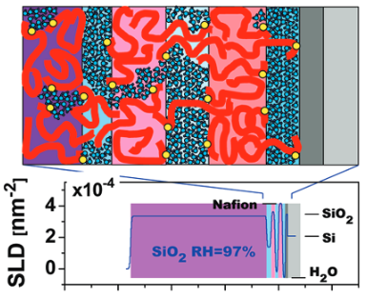
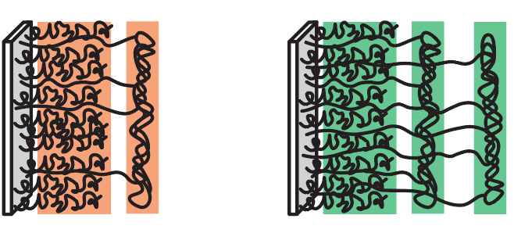
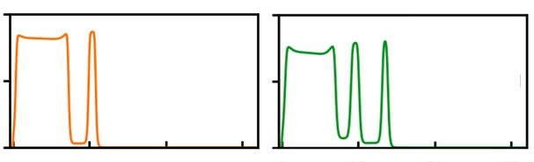
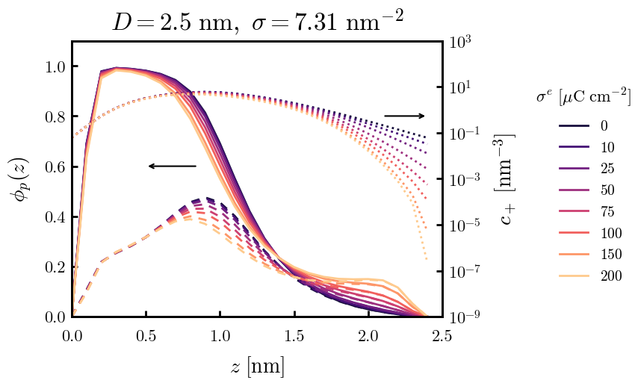
Last time
Polymer morphology is important (but complicated) in nafion membranes
Experiment
Theory
Self-consistent field theory can provide nafion microstructure under coupled physics
Elasticity vs. charge vs. hydrophobicity

Slide 4
Supplemental Slides

Slide 5
test

